Slide 1

Healthcare cost information from a HMO (Health Management Organization)
-Vedant Patil, Jenil Sheth, Shruti More, Collin Taylor

Slide 2
Project Goal
The dataset includes statistics on healthcare expenses from an HMO (Health Management Organization).
In the dataset, a person is represented by each row.
The case's main objective is to deliver actionable insight based on the available data and precisely estimate which individuals (clients) will be expensive.
The objective of my team is to understand the primary factors that influence why some individuals are more expensive (i.e., require more medical attention) and to forecast which individuals will be expensive (in terms of medical expenses).

Slide 3
Focus Areas
Identify the individuals who will spend a lot on healthcare in the upcoming year (which people will have high healthcare costs).
Provide the HMO specific advice on how to reduce health care expenditures in order to give them concrete information into how to reduce their overall health care costs.

Slide 4
Project Stages
Load the data with appropriate libraries
Explore the data
Data Cleaning
Overview of important variables
Data Visualization
Data Modeling and Trends
Shiny Apps
Recommendation with insights.

Slide 5
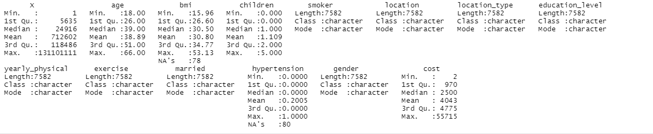
Data Overview
Data Structure
●7582 observations and 14 variables
●Variable Category:
* Numeric Variable: Age, bmi, children, cost
* Categorical Variable: X(ID),smoker, location, location_type, education_level, yearly_physical, exercise, married, hypertension, gender
●Target Variable: Cost -> Expensive

Slide 6
Overview of Important Variables
Age : The age of the person
location: Specifically, the state (in the United States) where the individual is from
smoker: A categorical response, "yes" if the respondent smoked in the year prior, "no" otherwise
Hypertension: “0” if the person did not have hypertension
bmi: Integer, the body mass index of the person. The body mass index (BMI) is a measure that uses your height and weight to work out if your weight is healthy.
cost: the entire cost of the person's medical care during the previous year.

Slide 7
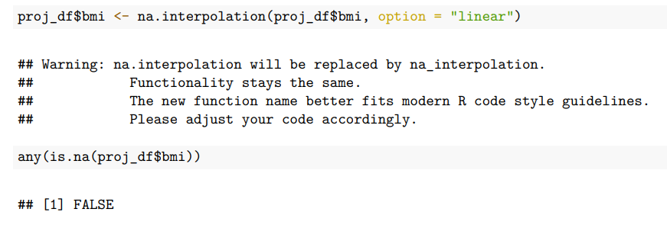
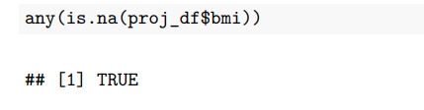
Data Cleaning
Verified any missing data consisting of 78 missing value in bmi and 80 missing value in hypertension using interpolation.
Data impute needed
Categorized the data into two parts expensive and inexpensive based on the attributes provided. (age, cost..)
Created new parameters for identifying cost to be expensive (If BMI is above 30, Smoker is yes, age is above 40)

Slide 8
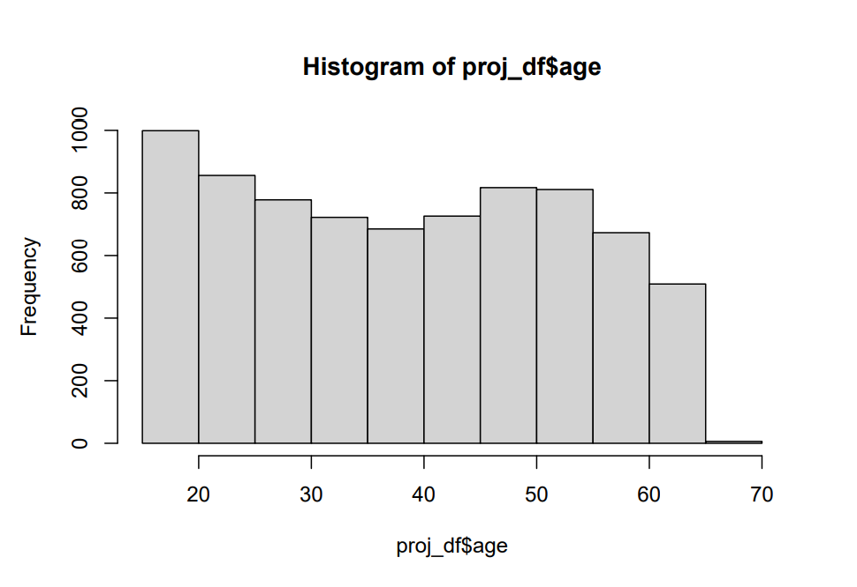
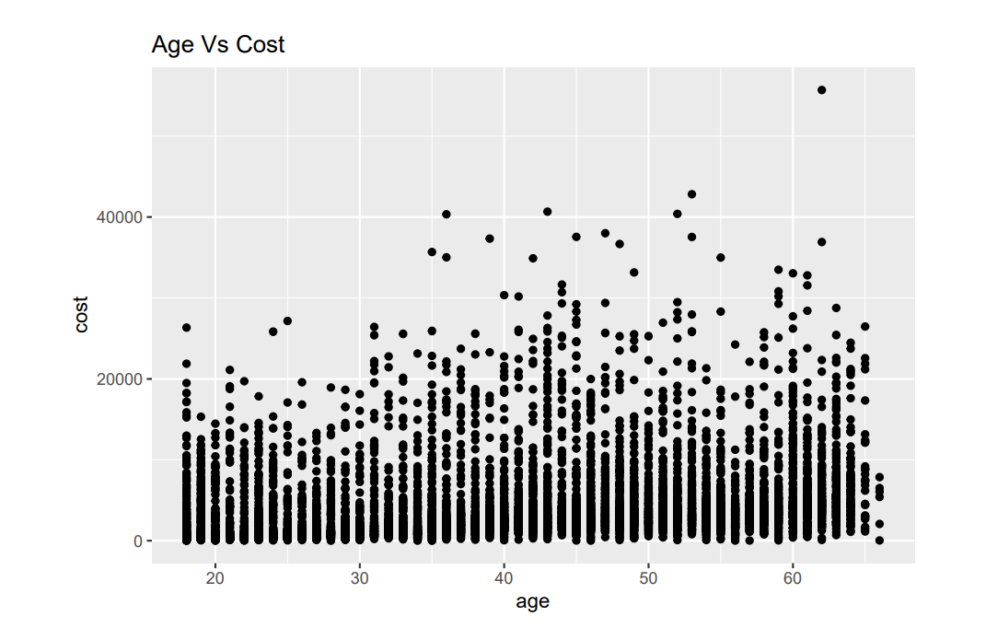
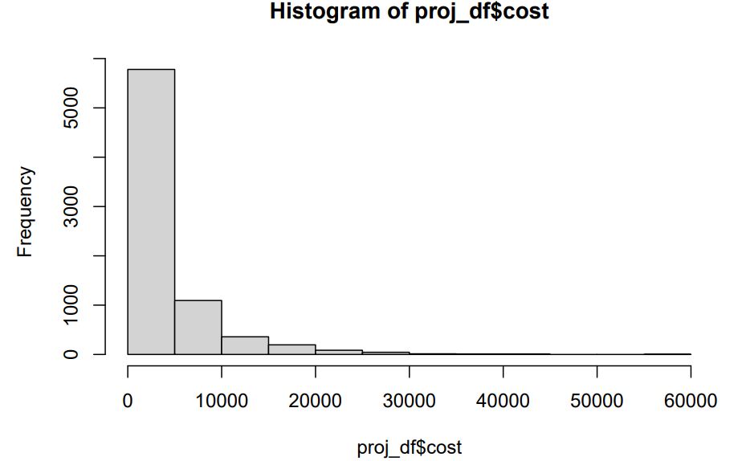
Exploratory Analysis (I)
Analysis done with respect to age and cost

Slide 9
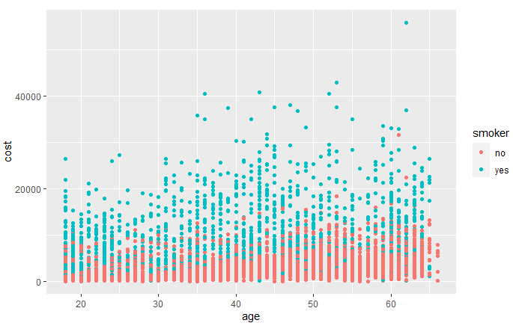
Exploratory Analysis (II)
The following scatter plot displays the distribution of members who are smokers with respect to their age and expenses

Slide 10
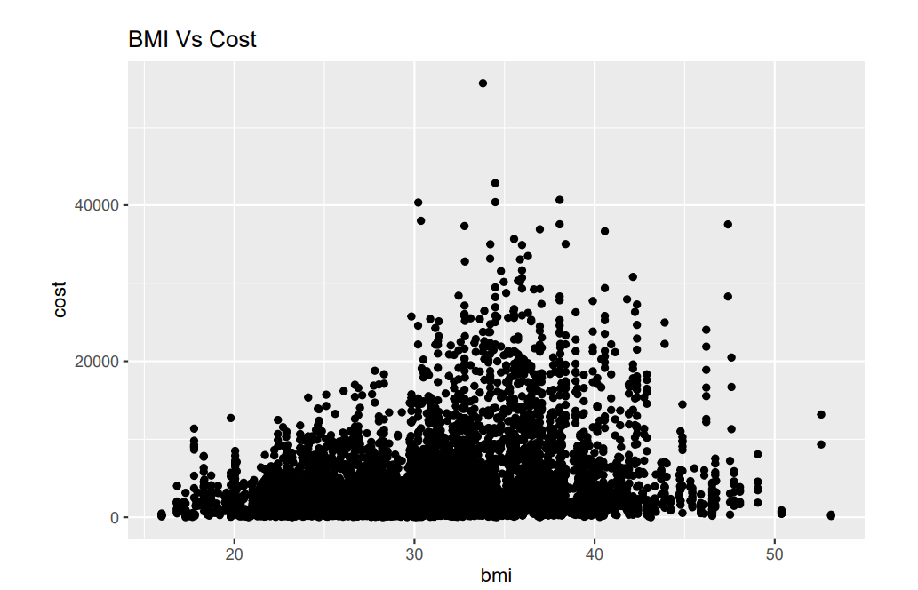
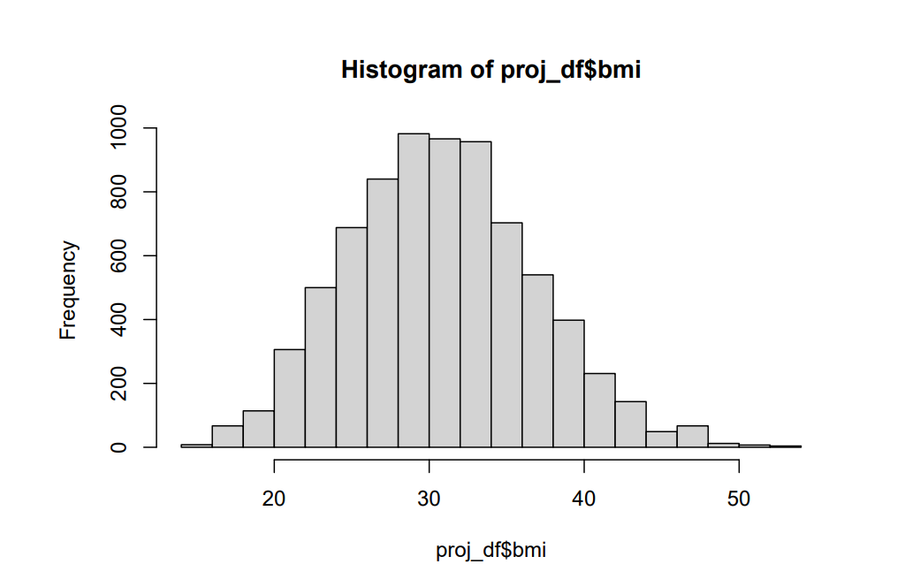
Exploratory Analysis (III)
Analysis done with respect to BMI

Slide 11
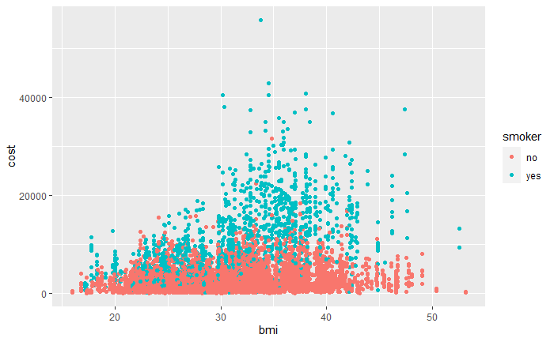
Exploratory Analysis (IV)
The following scatter plot displays the distribution of members who are smokers with respect to their BMI and expenses

Slide 12
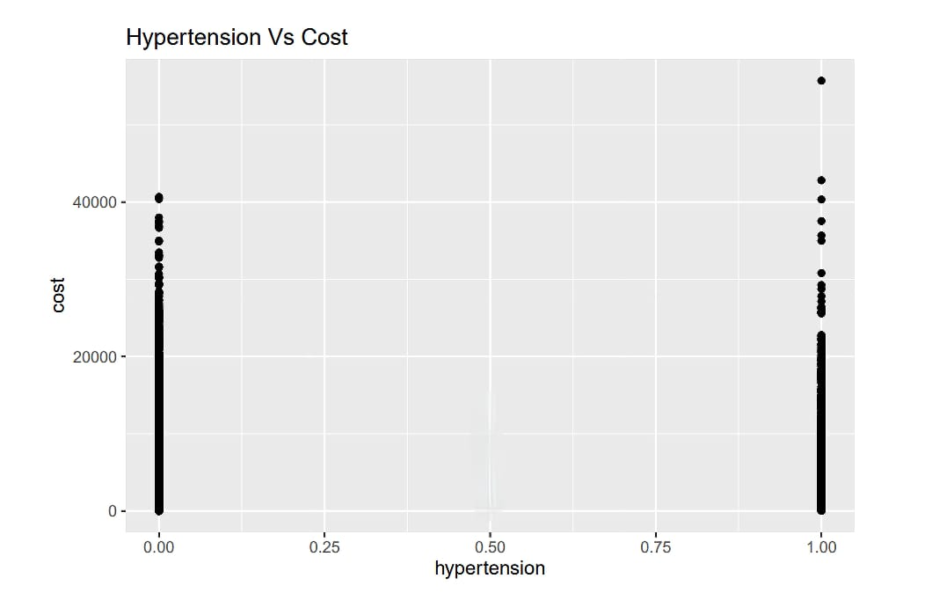
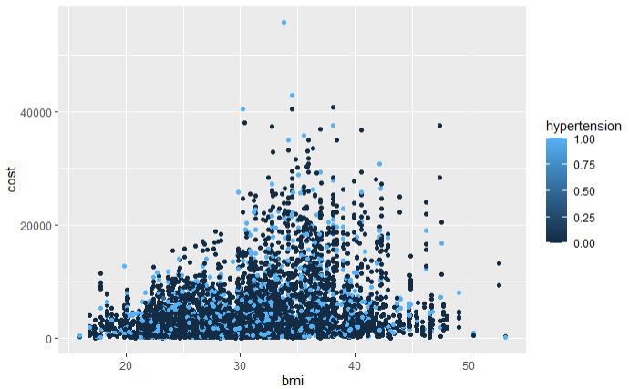
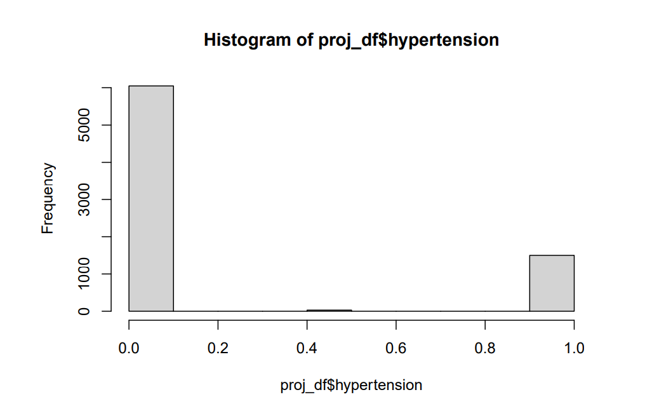
Exploratory Analysis (V)
Analysis done with respect to Hypertension

Slide 13
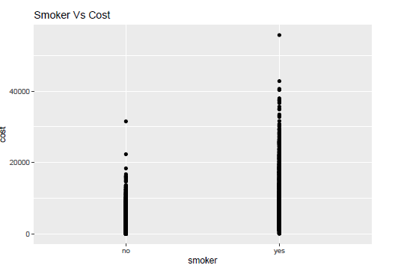
Exploratory Analysis (VI)
Analysis done with respect to smoker

Slide 14
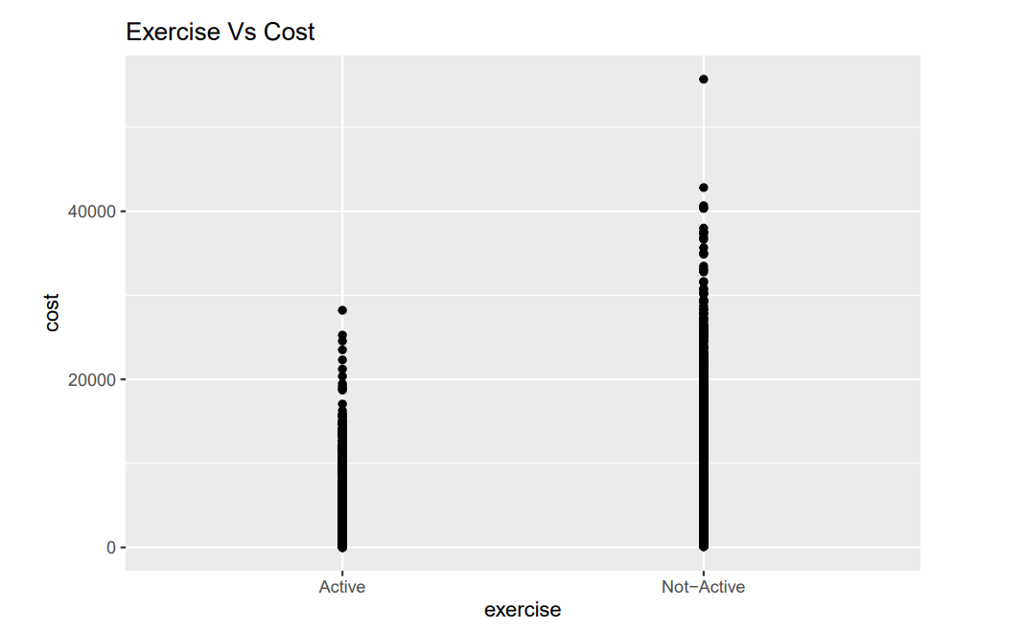
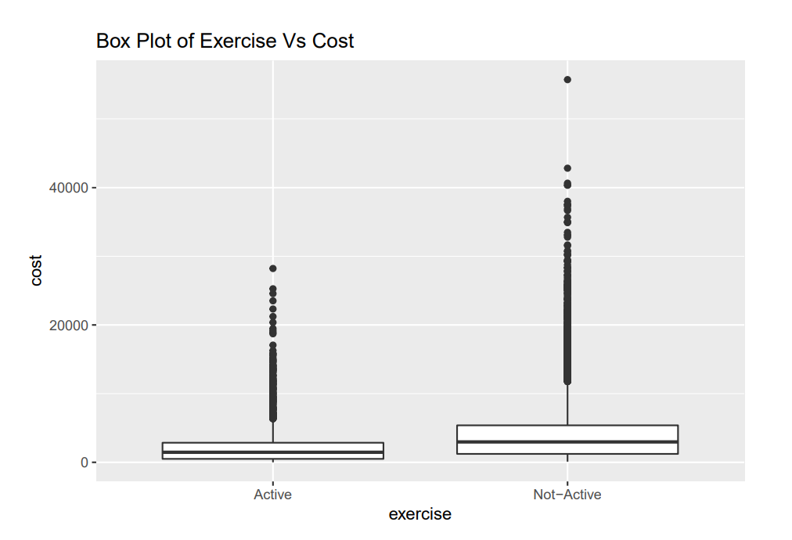
Exploratory Analysis (VII)
Analysis done with respect to exercise

Slide 15
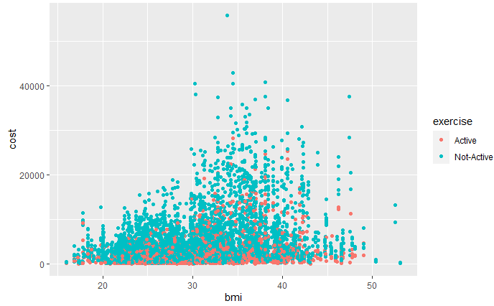
Exploratory Analysis (VIII)
The following scatter plot displays the distribution of members who exercise with respect to BMI and Healthcare Costs

Slide 16
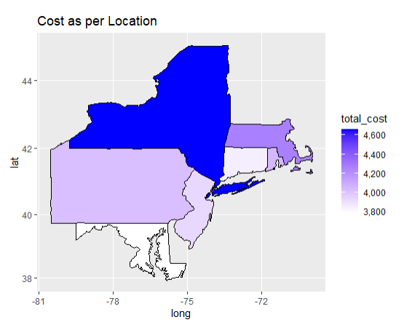
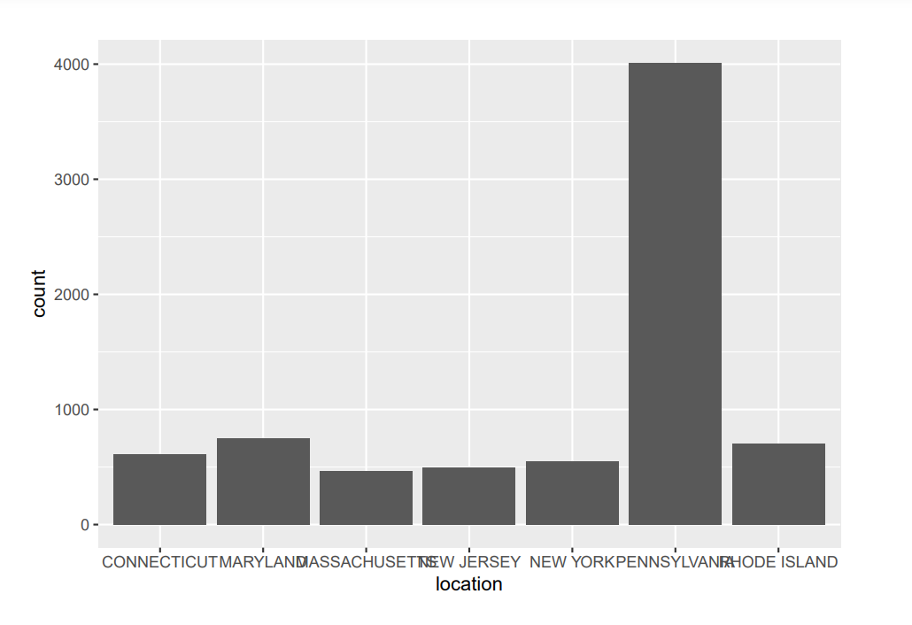
Exploratory Analysis (IX)
The distribution of patient total healthcare costs in the northeastern United States is shown.

Slide 17
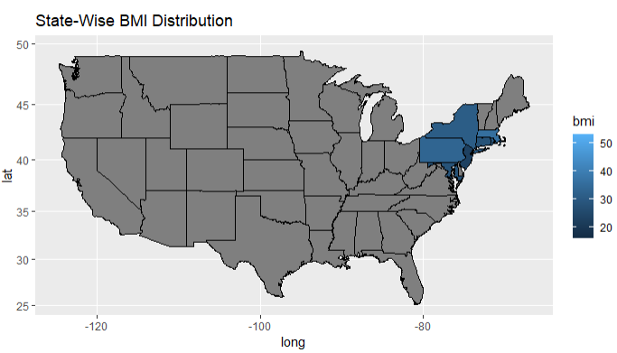
Exploratory Analysis (X)
This particular map displays the distribution of members based on their BMI value

Slide 18
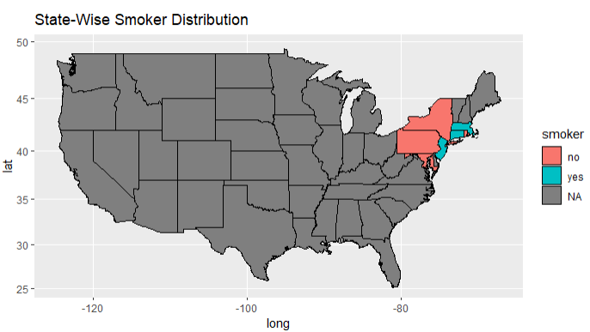
Exploratory Analysis (XI)
The distribution of states according to their population of smokers is shown on this map

Slide 19
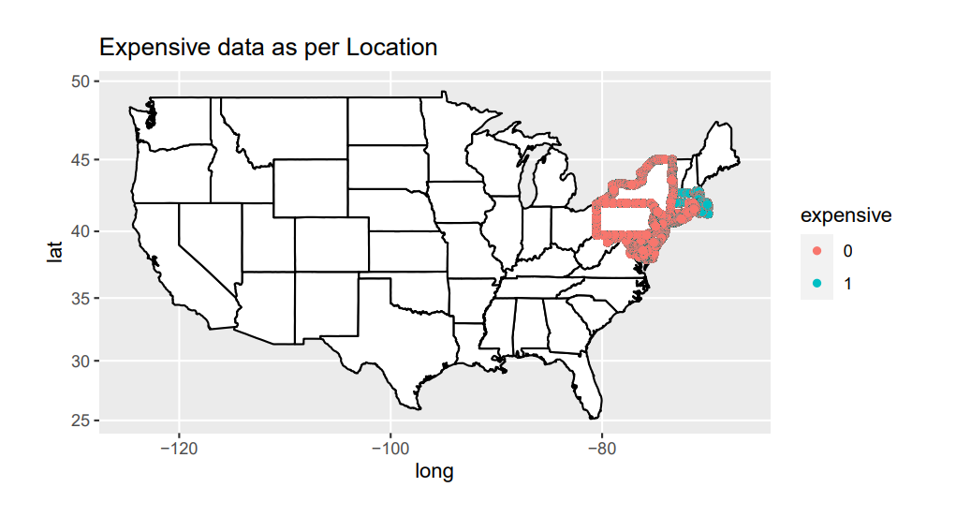
Exploratory Analysis (XII)
Differentiating the region with respect to expensive or inexpensive

Slide 20
Data Modeling Overview
We used three types of data models in this project
SVM Model
RPart Model
Multiple Regression Model
 | Accuracy | Sensitivity
Multiple Regression | 42.41%
SVM Model | 87.27% | 96.66%
R part/Tree Model | 86.74% | 98.20%

Slide 21
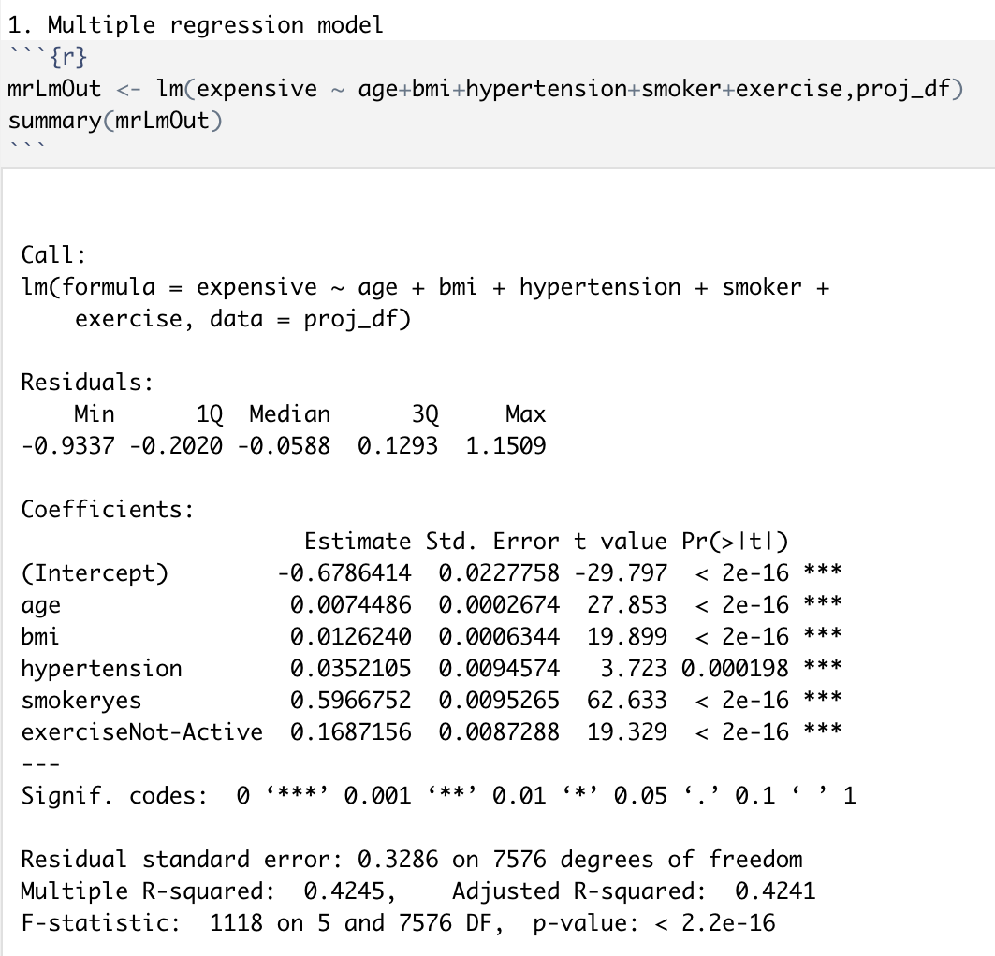
Multiple Regression Model
In this Linear regression model the Adjusted R-squared value is low which translates to low accuracy which is around 42.41% in this case. Even though, the Intercept and the variable itself is significant the accuracy is still low. This issue is caused mainly because of the huge amount of data set. For this model we have used the important variables which had an impact on cost based on our exploratory analysis the variables are age, BMI, Hypertension, smoker and exercise.

Slide 22
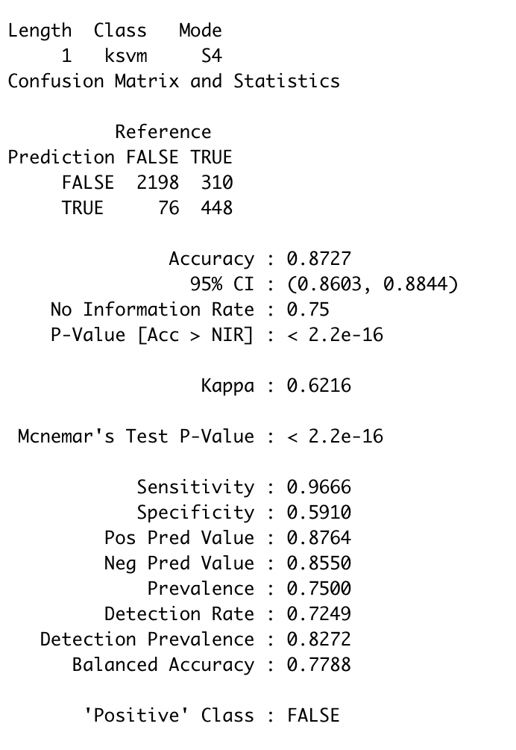
SVM Model
In the above SVM model 60% of the data in the data set was used for training and rest for testing. The accuracy of the model is 87.27% which is higher than the Multiple regression model. Also the sensitivity of the model is 96.66%. This makes the model very good for prediction.

Slide 23
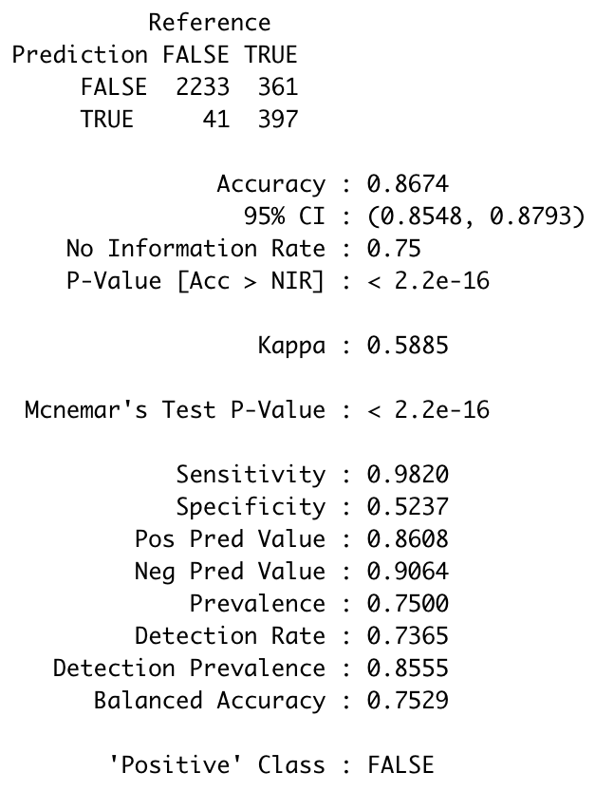
R Part/Tree Model
Here we can see that the accuracy of the model is 86.74% which is lower than the SVM model. But the sensitivity of the rpart model is 98.20% which is better than the SVM. This makes the rpart model the ideal choice for prediction and to be used in the shiny app.

Slide 24
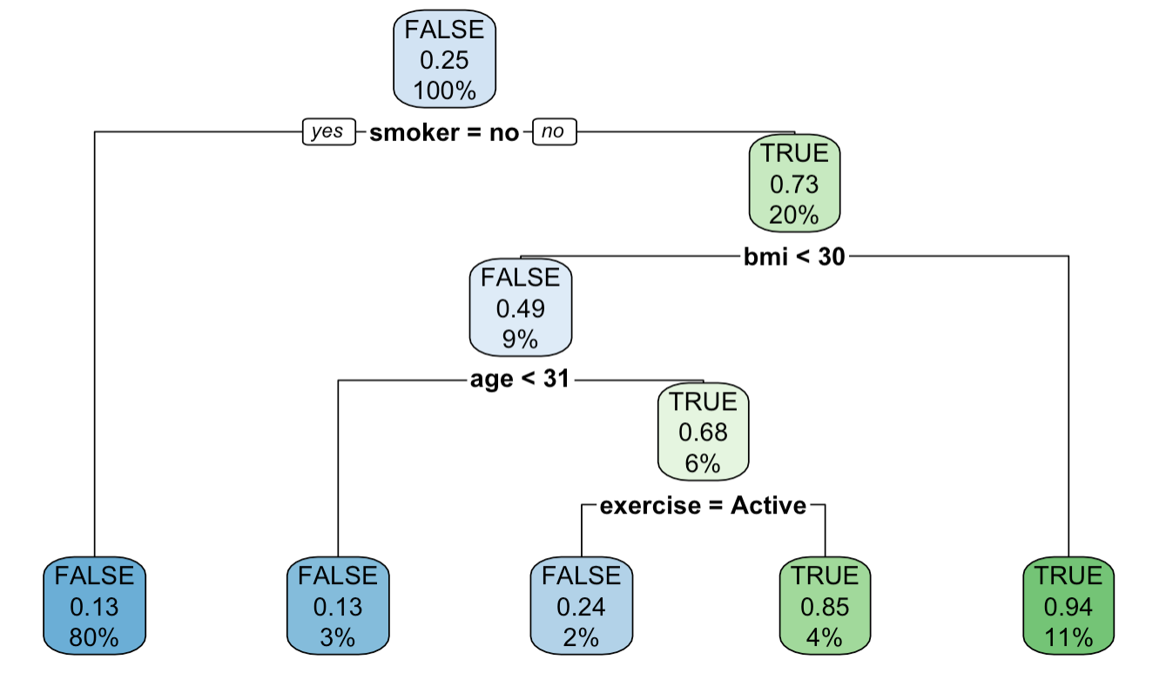
R Part/Tree Model

Slide 25
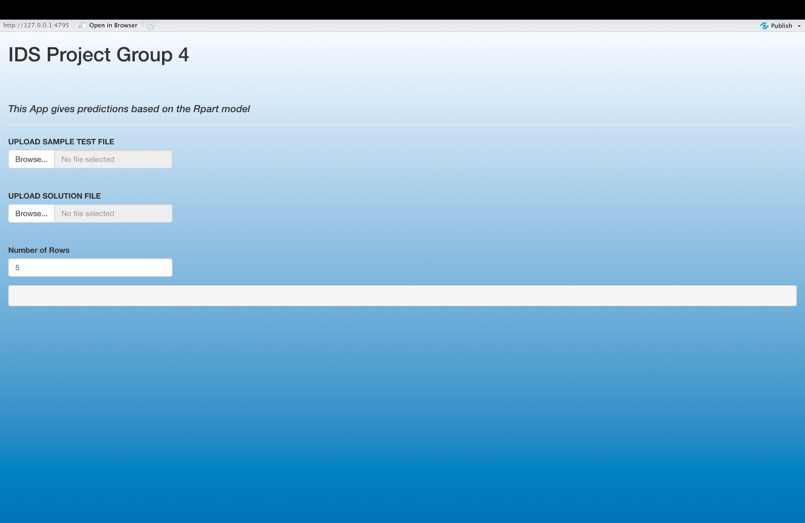
Shiny App

Slide 26
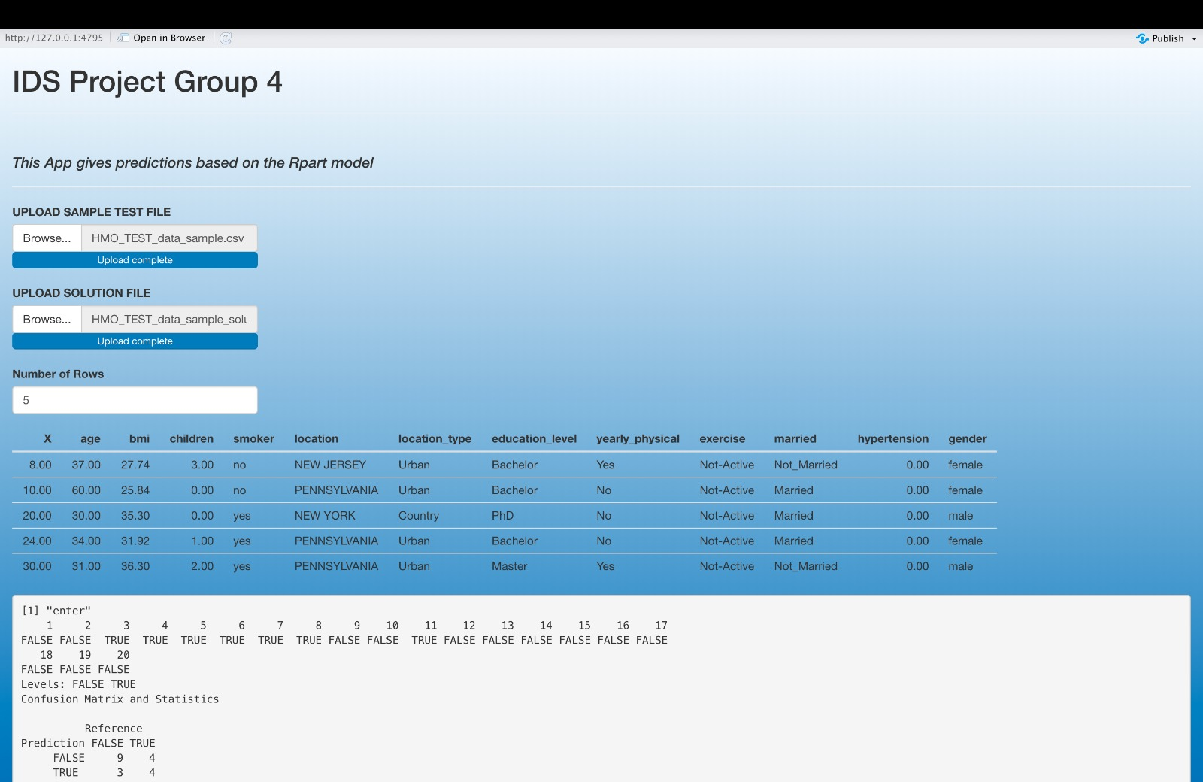
Shiny App

Slide 27
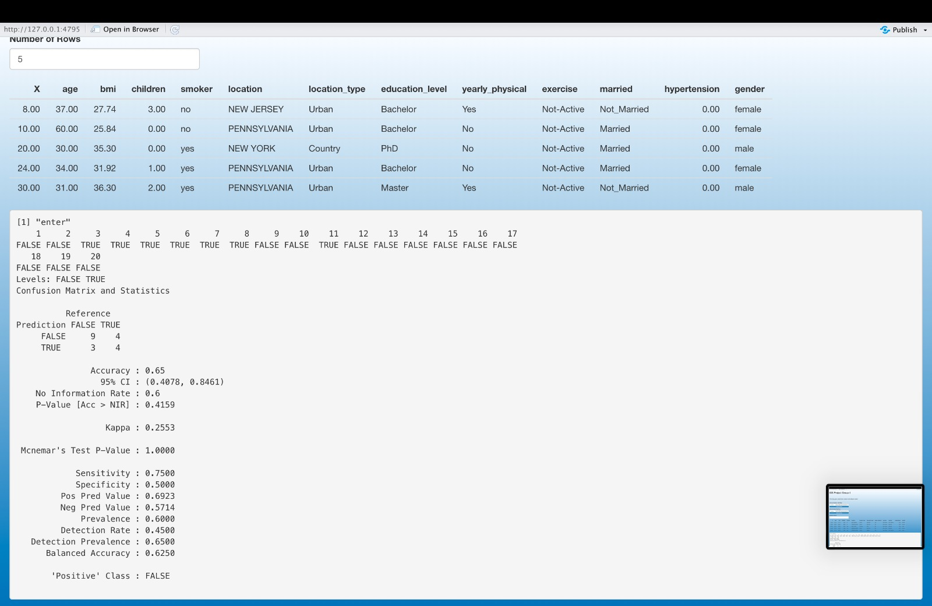
Shiny App

Slide 28
Recommendations
People that engage in particular behaviors are more likely to experience health issues, thus it is helpful to identify these customers using health survey questionnaires and suggest a low, medium, or high premium plan in accordance.
To incentivize customers using the health program, offer discounts on premiums for active participation with personal trainers.
Offer a health program that automatically enrolls customers in annual physicals and benefits such as a network of personal trainers.
To retain older aged customers, offer family HMO plans at reduced premiums. It is unlikely that all family members will require health care all at once or within a short period of time.

Slide 29
THANK YOU

